Slide 1
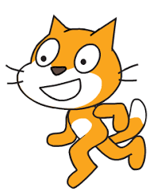
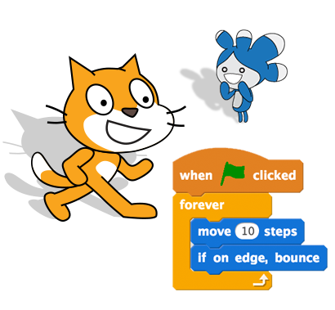
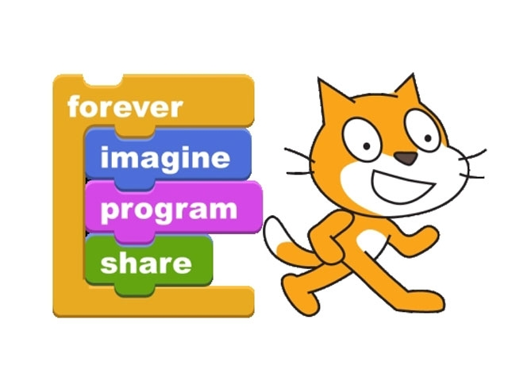
Scratch on! Using Scratch for Game Development
GBL online course: Rhythm4Inclusion
Dr Petros Lameras

Slide 2
What is Scratch?
Scratch is a game authoring environment for creating your own games.
You can also create animations and interactive stories.
It has been created by Lifelong Kindergarten group at MIT.
It is free and web-based available at http://scratch.mit.edu.
You can also download the offline version from https://scratch.mit.edu/download available for Mac, Windows, Linux. You need Flash Player and Adobe AIR available for download.
Launched in May 2007 - designers shared more than 7 million projects.
It is based on the principle of creative computing giving emphasis both on technical components but also in creativity
Designer vs consumer
Computational thinking
Sharing and Remixing

Slide 3
Getting Started
Creating an Account and setting your profile
Open a browser an navigate to the Scratch web site http://scratch.mit.edu
Click on join scratch at the top right

Slide 4
Creating a new project
Create a new project by clicking on the create button

Slide 5
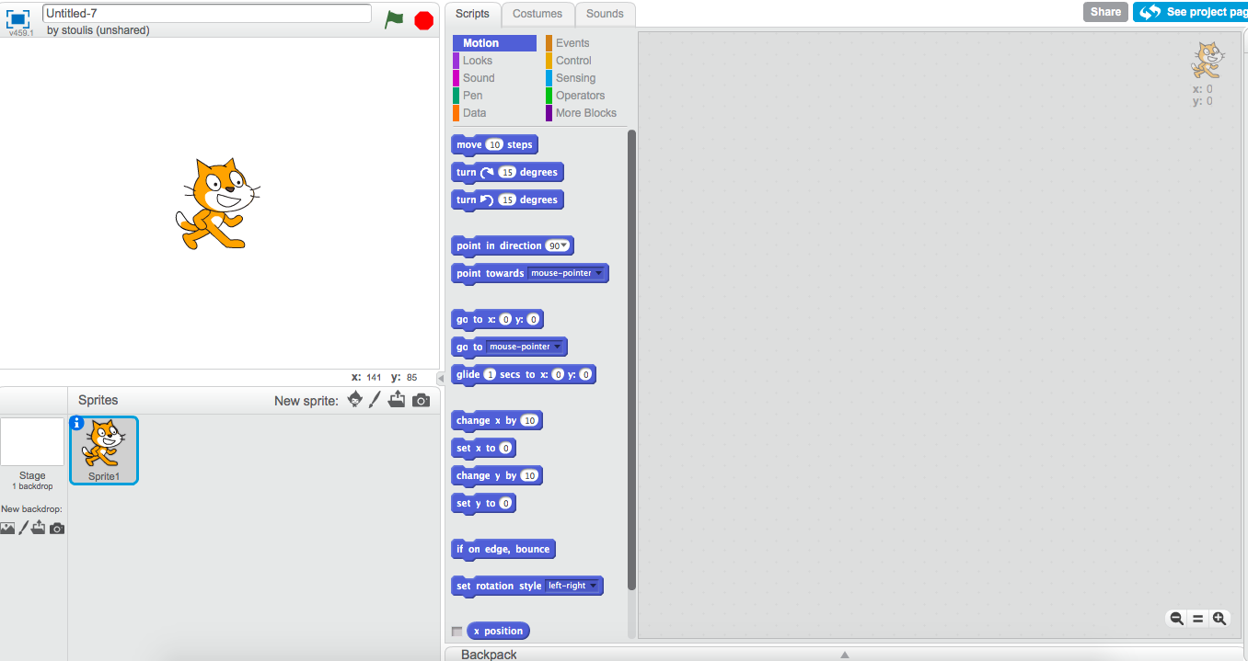
Creating a new project
Block Palette
The Stage
Scripts area
Sprite list

Slide 6
What is a Sprite?
In scratch every character or object is called a sprite. Every new project in Sprite starts with the Cat Sprite.
To add a Sprite
Choose the first icon to choose a new sprite from the library
Click the paintbrush to paint a new sprite
Click the file to upload a sprite
Click the camera to shoot your own live photo
To delete a sprite right click and select delete or click the scissors at the middle top grey

Slide 7
Change the background
You can change a backdrop from this icon
Select a backdrop from the library by clicking on the first icon
Draw your own backdrop by clicking the paint
Upload your icon by clicking the folder
Take your own backdrop photo

Slide 8
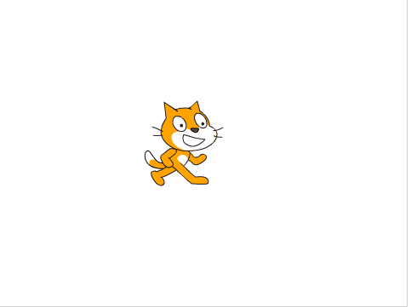
Where is your sprite?
y=180
X= 0, y=0
X=-240
X=240
y= -180

Slide 9
Save and Share Projects
Type your project’s title in the empty space at the top
Click on the see project page
Type instructions, notes and credits
once you are happy, click share

Slide 10
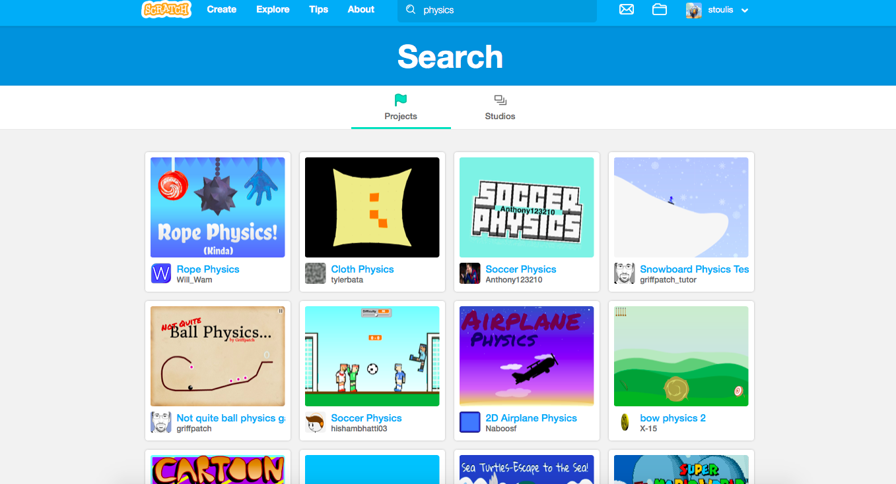
The Scratch Community

Slide 11
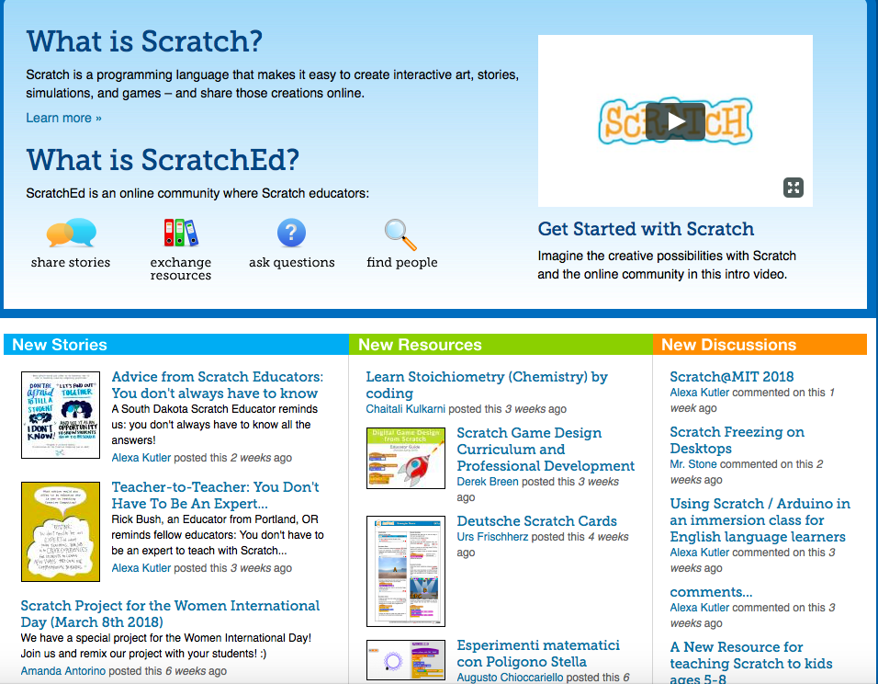
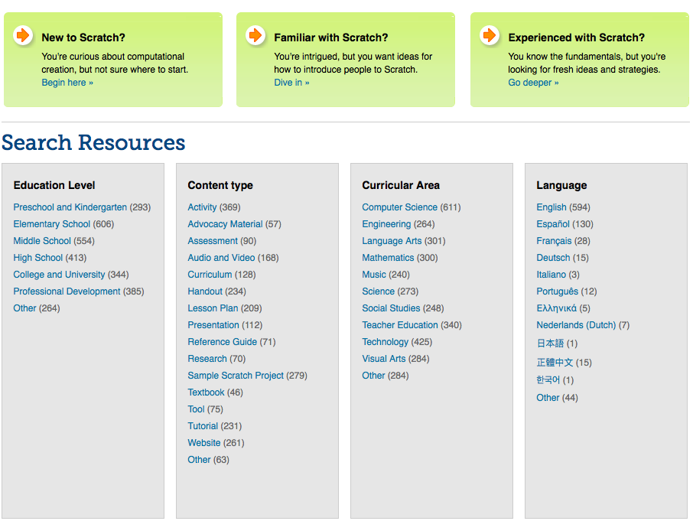
The ScratchEd community

Slide 12
Let’s start creating our first game
Click Create
Click on the ‘tips’ tab
Select ‘Getting Started with Scratch’ game

Slide 13
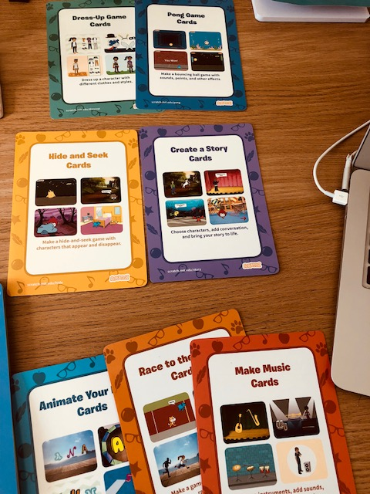
Scratch Coding Cards
Let’s start make our own games by using the Scratch coding cards
You will find 10 sets of cards
Animate your name
Race to the finish
Make music
Hide and seek
Create a story
Dress-up Game
Pong Game
Let’s Dance
Catch Game
Virtual Pet
Each set has 7 sub-cards with the front describing what you will create and the back shows how you will create it by using the scratch blocks
Each team member takes 2 card sets and starts developing the coding task
Once you finish, you can exchange cards with others to finish all coding cards.
30 minutes to complete the coding activities described in the cards

Slide 14
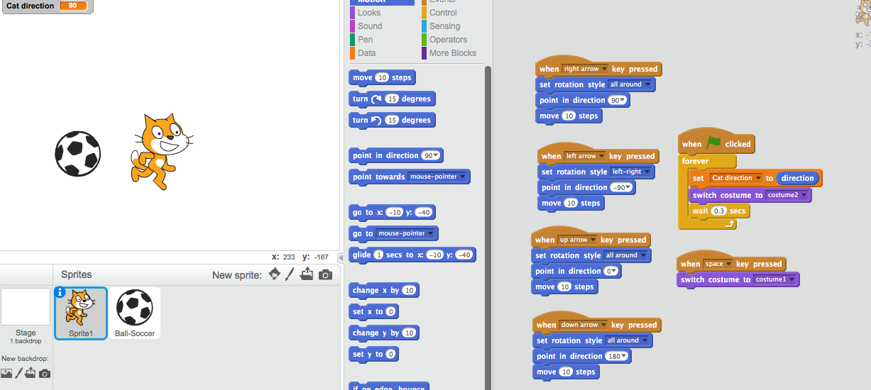
A bit more advanced ‘Kicking the ball’ game.

Slide 15
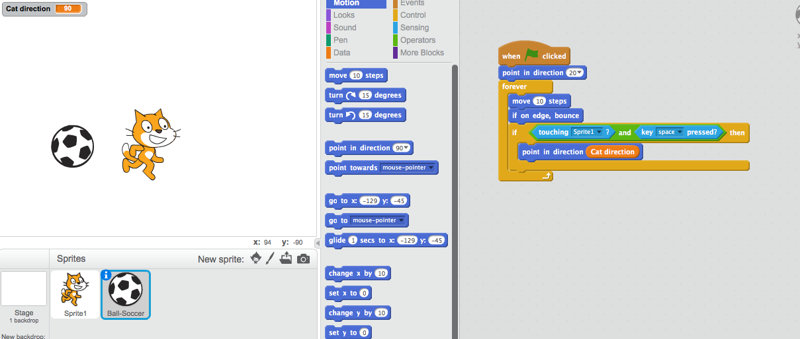
A bit more advanced ‘Kicking the ball’ game.

Slide 16
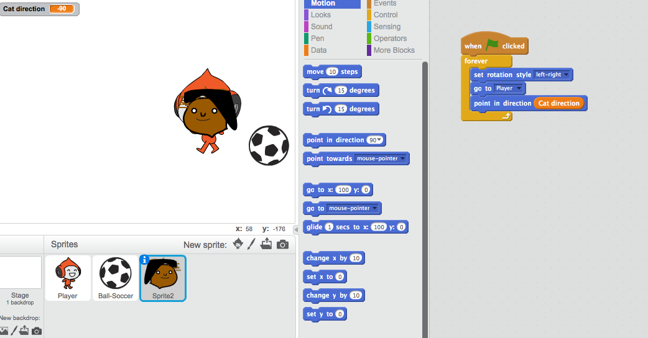
A bit more advanced ‘Kicking the ball’ game.

Slide 17
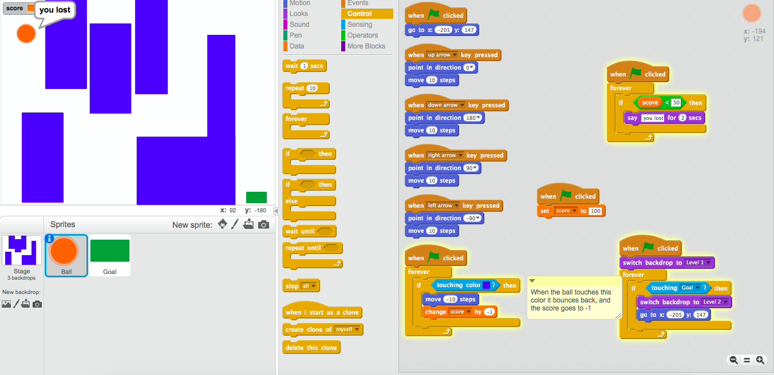
Remixing The “MAZE”

Slide 18
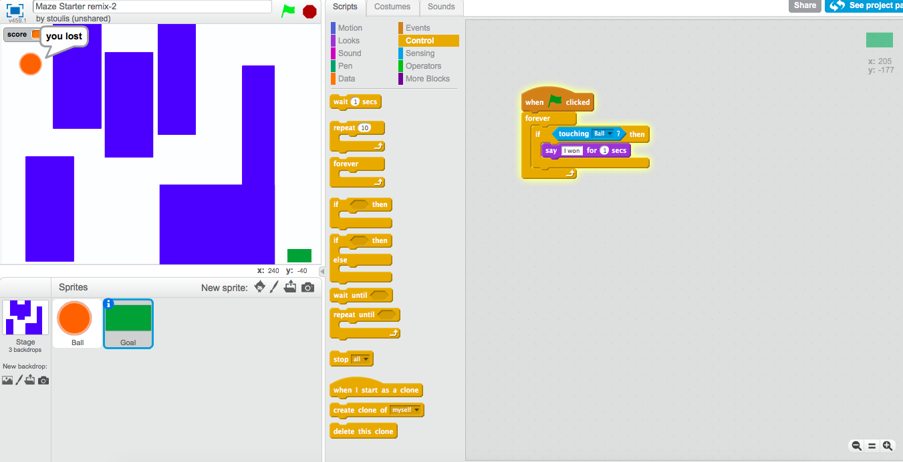
Remixing The “MAZE”

Slide 19
Your turn now to create your own scratch game
It can be any type of game you wish to make
It can be even an educational game inspired from these ones for science, social sciences, maths.
Women through historyhttps://scratch.mit.edu/projects/171610974/#editor
Like the math-race: https://scratch.mit.edu/projects/13853051/
Or a Greek God Trivia https://scratch.mit.edu/projects/61351686/
Or Parts of a flower https://scratch.mit.edu/projects/1952645/
The Greek flag https://scratch.mit.edu/projects/98165053/
Description of the Animal Cells https://scratch.mit.edu/projects/2072182/
The ninja game https://scratch.mit.edu/projects/164442233/

Slide 20
Your turn now to create your own scratch game
You can create a new game from scratch or you can remix any of the code or entire game from the game cards or from the kicking the ball or from the projects shared in the Scratch website by clicking ‘see inside’
Be as creative as possible. Try to combine the content of the game with your teaching interests or something you would like to show to your students in an interactive way.
Think how you could incorporate scratch in your teaching
Would be great to show to your students the game you have created and present to them how you have made it
You could try to transfer you game designs to your Scratch development
If too complex, don’t worry you can create something totally new based on your teaching interests or it could be something combining learning with fun or just fun!

Slide 21
Developing and presenting your games
You have 120 minutes to develop your game
45 minutes to create your presentations of how you have developed your games. Your presentations could include
Your game idea (in the slides)
Live Demo of your game (in scratch)
Sharing your game in scratch
How would you incorporate your game to your teaching curriculum?

Slide 22
Resources for game design in scratch and integrating creative computing in the curriculum
To start off, here is a list of resources you could use for designing your curriculum through using scratch.
Creating games in Scratch in Greek!! http://www.scratchplay.gr/contents/scratchplaybook.pdf
The Scratch cards in digital form for free https://scratch.mit.edu/info/cards/
Creative computing curriculum https://docs.google.com/spreadsheets/d/19ycOL_ko9HAhtrC0IeDlKRPVnb0SUa6aIn7-M1_oTt4/edit#gid=911448880
The concept of computational creativity and creative computing https://www.youtube.com/playlist?list=PL9ngVLPWKfDmJMKk804iU3V4Xrf_PxPFQ
Teachers showcasing best practices in using Scratch http://scratched.gse.harvard.edu/resources/scratch-educator-show-tell-videos
Creative computing curriculum guide with example projects and learning outcomes for each unit http://scratched.gse.harvard.edu/guide/files/CreativeComputing20141015.pdf
For a plethora of resources for different subject areas, visit Scratch Ed http://scratched.gse.harvard.edu/resources/new-scratch

Slide 23
Serious Game Design Workshop for Introducing Computational Creativity Using Scratch
at Coventry University
Scratch
Tera
Gobo
Pico
Thank you

